Slide 1
Language, Brain,
and Computation
Christos H. Papadimitriou
Columbia University

Slide 2
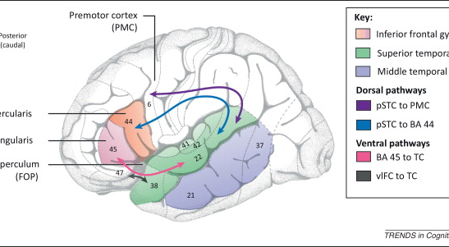
How does language happen?
Wernicke’s area
Broca’s area

Slide 3


Slide 4
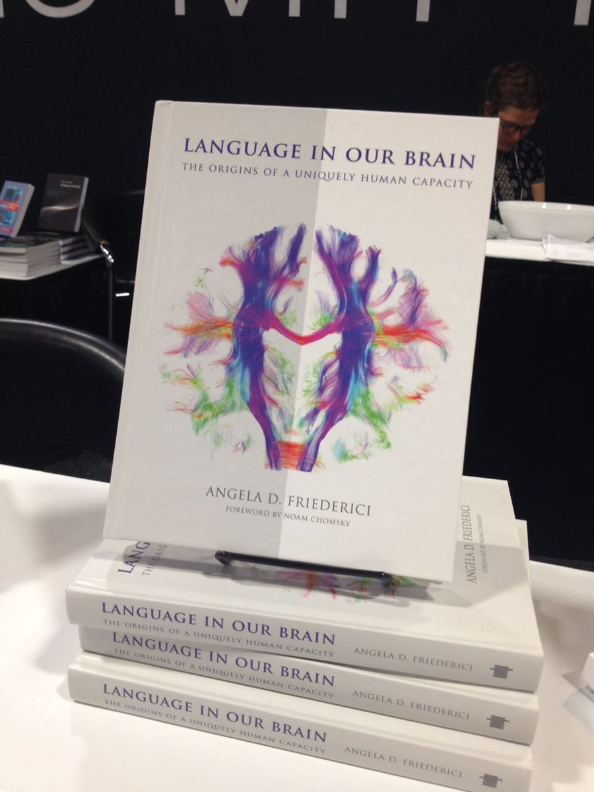

Slide 5
But why Language?
A last-minute adaptation
Hypothesis: it evolved so as to exploit the brain’s strengths
Invaluable lens for studying the brain
A deluge of recent experiments!

Slide 6
The [Poeppel 2016] experiment
fret
ship
hill
give
true
melt
fans
blue
guess
hits
then
cats
4 hertz

Slide 7
The [Poeppel 2016] experiment, stage II
bad
cats
eat
fish
new
plan
gave
joy
little
boy
kicks
ball
1 2 4 hertz

Slide 8
My interpretation
bad
cats
eat
fish
new
plan
gave
joy
little
boy
kicks
ball
1 2 4 hertz

Slide 9

How are these trees created? in about a dozen spikes per step? (Why a dozen? neuron spikes ~ 50Hz : language ~ 4Hz)

Slide 10
[Frankland & Greene PNAS 2015]
“The ball hit the truck”
vs
“The truck hit the ball’’
Different areas of the Superior Temporal Gyrus (STG) responded to “truck” in the two sentences
The first area also responded to
“The truck was hit by the ball”

Slide 11

Where is the superior temporal gyrus, Mr President?

Slide 12


Slide 13
Zaccarella & Friedericci “Merge in the human Brain” Front. Psych. 2015
The completion of phrases, and especially of sentences, activates parts of Broca’s area

Slide 14
Really, how does language happen?
Broca’s
area
Wernicke’s
area
Lexicon

Slide 15
Language mirror cells?
But the dynamic aspects of the mechanism are still a mystery
The emerging understanding suggests that populations of neurons are created on-the-fly to encode syntactic elements, and to “communicate” with each other.
[Friederici p. 134] Hypothesizes “language mirror cells”

Slide 16
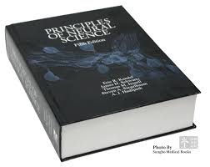
How does the Mind emerge from the Brain?

Slide 17
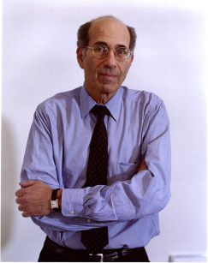
“…we do not have a logic for the transformation of neural activity into thought ... I view discerning [this] logic as the most important future direction of neuroscience…”
Neuron, Sep 2018

Slide 18
So, what kind of formal theory would qualify as Axel’s logic?

Slide 19
Computation in the brain: What is the right level?
Whole brain?
Spiking neurons and synapses?
Dendrites?
Molecules?
?

Slide 20
The assembly hypothesis
There is an intermediate level of brain computation
Call it the Assembly Calculus
It is implicated in higher cognitive functions such as reasoning, planning, language, story-telling, math, music, …
Assemblies of neurons are its basic representation – its main “data structure”

Slide 21
Assembly (or ensemble)
[Hebb 1949, Harris 2003, 2005; Buzsaki 2008, 2010, Yuste et al. 2019,…]
A large and densely intraconnected set of excitatory neurons in a brain area whose firing (in a pattern) is tantamount to our thinking of a particular memory, concept, name, word, episode, etc.
G. Buzsaki 2020: “assemblies are the alphabet of the brain”

Slide 22
Back to the assembly hypothesis
What are the operations of the Assembly Calculus?
Projection
Association
Pattern completion
Merge
Reciprocal projection
...plus a few control commands

Slide 23
Projection of an assembly
area A
area B

Slide 24
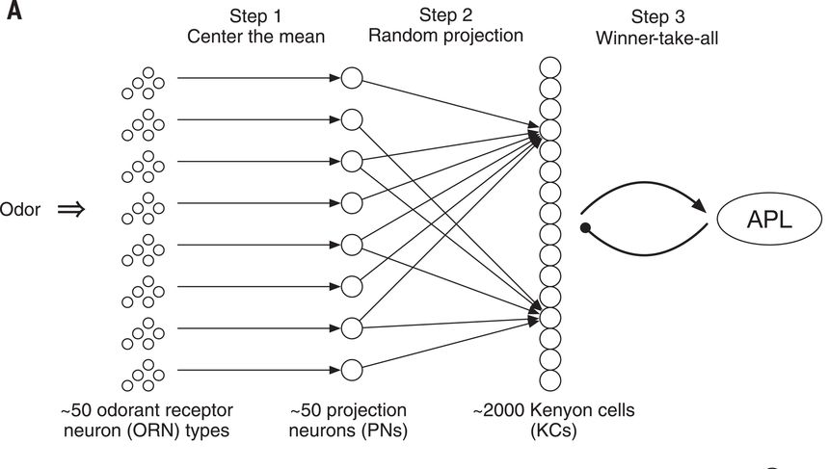
How fruit flies remember smells
random
projection
followed by cap (RP&C):
100 winners
(out of 2000)
take all

Slide 25
How fruit flies remember smells
Q: but wait a minute! Is this
a random
bipartite
graph?

Slide 26
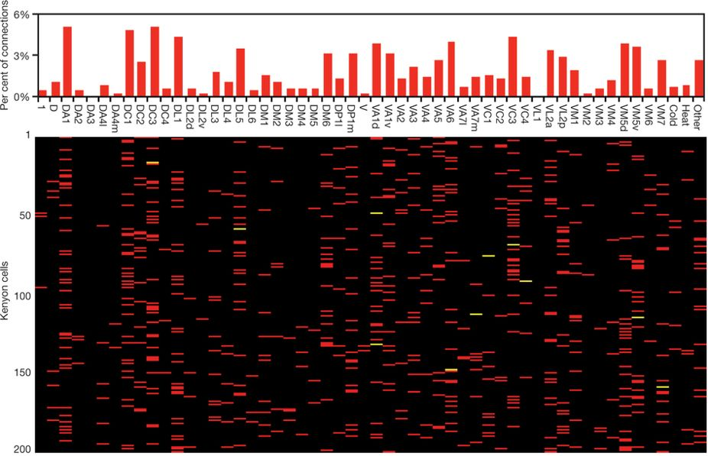
A: Random convergence of olfactory input in the Drosophila mushroom body by S. Caron, V. Ruta, L. Abbott, R. Axel,2013
Bottom line:
looks like a random bipartite graph,
except that the degree distribution
of the LHS is not uniform

Slide 27
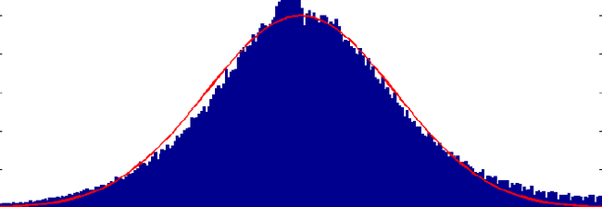
RP&C
k

Slide 28

So much for the fruit fly…
Q: Does something homologous
happen in mammals?

Slide 29
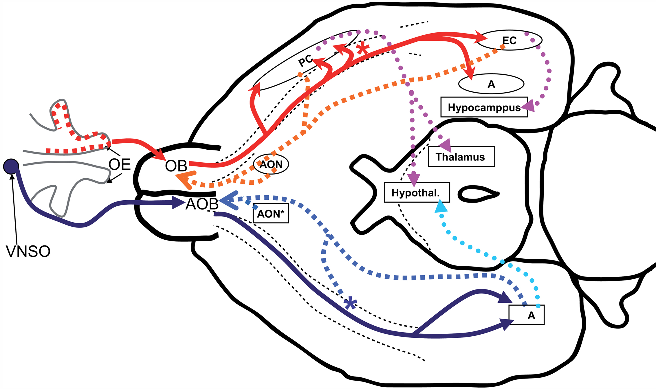
Yes!
K. Franks, M. Russo, S. Sosulki, A. Mulligan, S. Siegelbaum, R. Axel
“Recurrent Circuitry Dynamically Shapes the Activation of Piriform Cortex,” Neuron October 2011

Slide 30
Big difference: The mammalian brain has recurrent connections
From the Discussion section of Franks et al.:
An odorant may [cause] a small subset of [PC] neurons [to fire].
Inhibition triggered by this activity will prevent further firing
This small fraction of ... cells would then generate sufficient recurrent excitation to recruit a larger population of neurons.
In the extreme, some cells could receive enough recurrent input to fire … without receiving [initial] input…

Slide 31
In pictures…
set of spiking
neurons
RP&C
Also, Hebbian
plasticity
third RC&P,
and so on…
new RC&P

Slide 32
Does this process converge?
math model?

Slide 33
A mathematical model of the brain
Finite number of brain regions
Each contains n neurons
Inhibition: only k fire
Some pairs of areas are
connected by directed B_{n,p}
(= bipartite G_{n,p})
All are recurrently connected
by directed G_{n,p}

Slide 34
The model (cont.)
Neurons fire in discrete steps
Selected by RP&C
Connections between areas can
be enabled/disabled
Plasticity: If i→j, i fires and in the
next step j fires, the weight of
i→j is multiplied by (1 + β)
Also: homeostasis, forgetting

Slide 35
Main parameters, intended values
n ~ 10⁷
k ~ 10³ ⁻ ⁴
p ~ 0.001
β ~ 0.10
Main ideas: randomness, selection, plasticity
NB: (1) discrete steps (2) time scale of assemblies (3) and of plasticity

Slide 36
Theorem (P., Vempala 2016-18): The projection process converges exponentially fast, with high probability, and the total number of cells involved is at most:
If β ≥ β*: k + o(k)
If 0< β < β*: k⋅exp(0.17⋅ln(n/k)/ β)
β* = (√2 -1)/(1 + √pk/ln n)

Slide 37
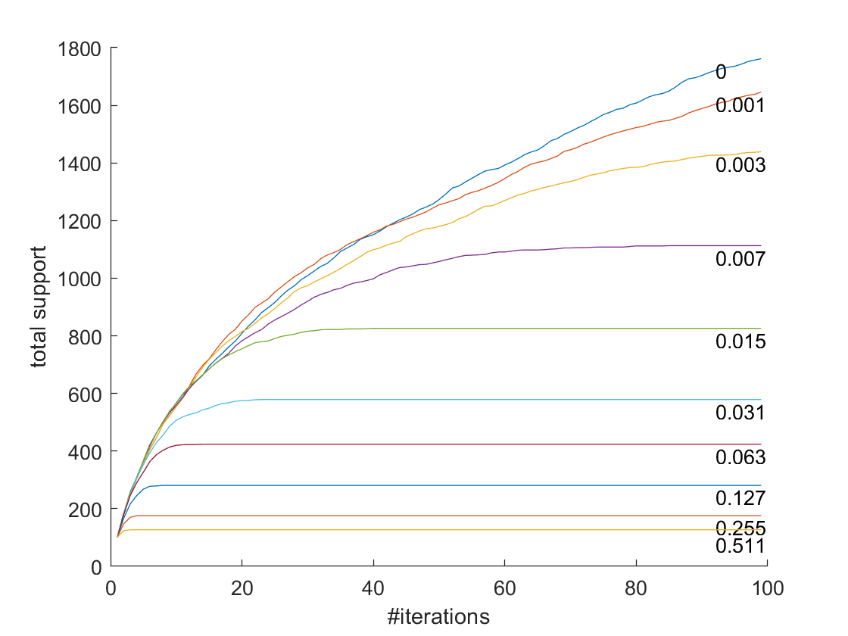
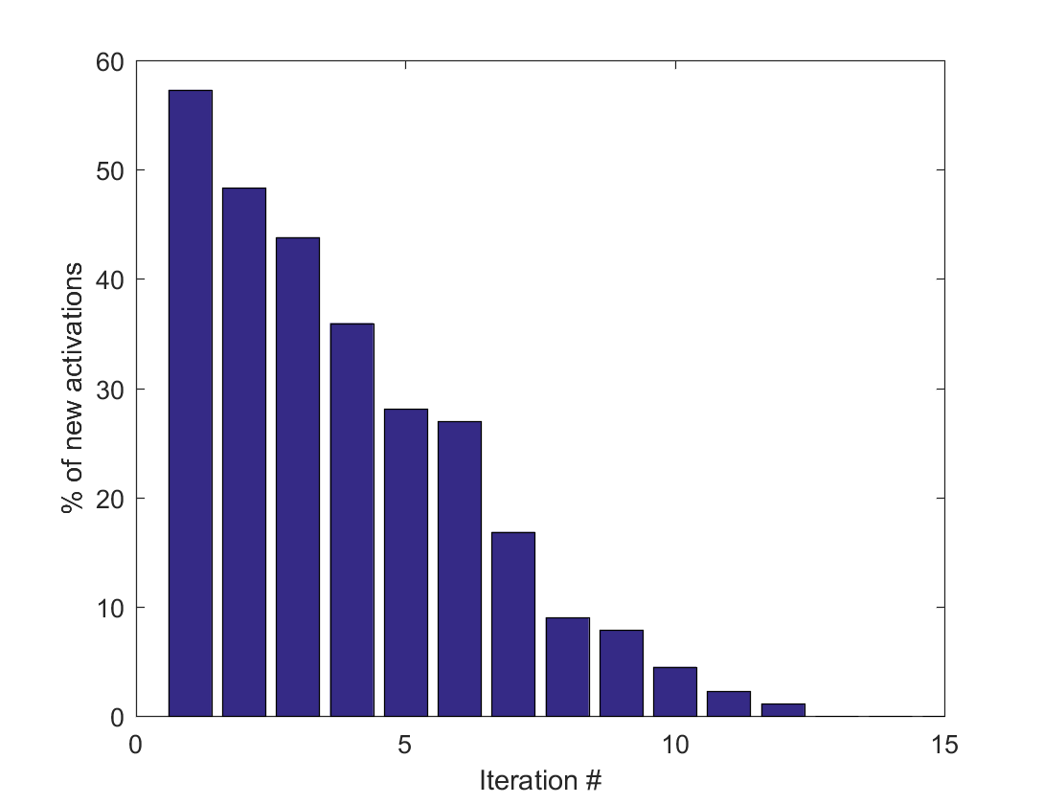
k = 100

Slide 38
Association of two assemblies

Slide 39
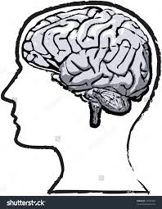
The [Ison et al. 2016] experiment

Slide 40
The [Ison et al. 2016] experiment

Slide 41
The [Ison et al. 2016] experiment

Slide 42


Slide 43


Slide 45


Slide 46


Slide 50
Merge of assemblies: it’s complicated…

Slide 51
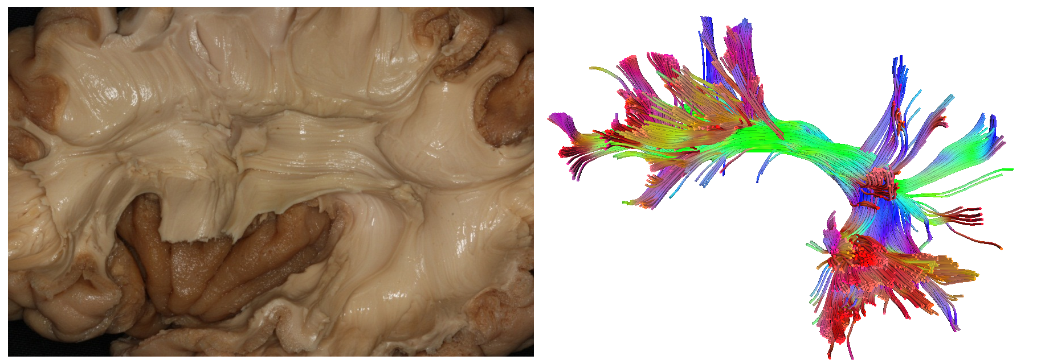
Merge: Does it need enhanced hardware? (The mystery of the Arcuate Fasciculus)

Slide 52
Assembly operations are real
They correspond to behaviors of assemblies that have been observed in experiments…
…or are strongly suggested by experiments, cf Merge
They can be “compiled down” to the activity of neurons and synapses, through
Mathematical proofs and simulations in our simplified model of cortex
Simulations in systems of neuro-realistic spiking neurons

Slide 53
Assembly Calculus recap
project(y, B, x)
associate(x, y)
pattern_complete(x, y)
merge(x, y, B, z)
Plus: activate(x), read(), disinhibit(A)
Q: How powerful is this system?
A: can perform arbitrary √n-space computations

Slide 54


Finally: a brain architecture for syntax
S
VP
boy
kick
ball
boy
kick
ball

Slide 55
Assemblies help explain how to construct a sentence scaffold!
Comprehension: same mechanism – plus on-line parsing, ambiguity resolution, …
Production (without articulation) may be much more ancient
Planning and story-telling may use the same merge apparatus and pathways
The mystery of the S-V-O word orders
S
V
O

Slide 56
The SVO map of languages…
SOV: 45% Japanese, Urdu, Latin, Ancient Greek, Korean, Sanskrit,…
SVO: 42% Chinese, English, Hebrew, Greek, German, Spanish, Thai,…
VSO: 9% Biblical Hebrew, Arabic, Welsh, Filipino,…
VOS: 3% Malagasy, Car,…
OVS: 1% Apalai,…
OSV: 0.01% Warao

Slide 57
Explanation?
[Diel 1975], [Mallinson and Blake 1981],[Krupa 1982], [Tomlin 1986], … Various systems of linguistic principles; S-V-O orders are sorted in decreasing degree of compliance with these principles
[Manning and Parker 1989, 1991] “Semantic diagram”
[Maurits 2011, 2014] SVO frequencies are the steady state distribution of a Markov chain. Languages evolve, word orders change, and one can estimate the transition rates

Slide 58
S-V-O word orders: a computational explanation
Recall that syntax tree
Articulation strategy: selecting a permutation of the three leaves
How is an AS implemented?
S
V
O

Slide 59
AS implementation through lock an unlock
An internal node may lock a child (when it fires)
A leaf may unlock another leaf (again, when it fires)
Eg, S-O-V (see figure…)
(already explains why SOV, SVO >> others…)
S
V
O

Slide 60
S-V-O word orders: a computational explanation
Suppose f(𝝿) ~ exp(-complexity(𝝿))
Complexity = sum of ”costs” of lock and unlock steps
Gradient descent → values for unlock costs between leaves
Prediction: OV ~ VO, SV >> VS
S
V
O

Slide 61
Sooooooo…
The study of the Brain is fascinating and bottomless
Assemblies and their operations may be one productive path to thinking about computation in the brain
Conjectured architecture for basic syntax in language
Are assemblies the seat of Axel’s “logic”?
How do assemblies learn and predict?
How can one test/verify/falsify the Assembly Hypothesis through experiments?

Slide 62



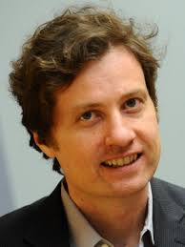
my collaborators!
(paper in bioRxiv)
Santosh Vempala
GaTech
Dan Mitropolsky
Columbia
Wolfgang Maass
TUGraz
Mike Collins
Columbia

Slide 63
Thank You!

